Slide 1

Reports & Type Of Reports
Page 1

Slide 2
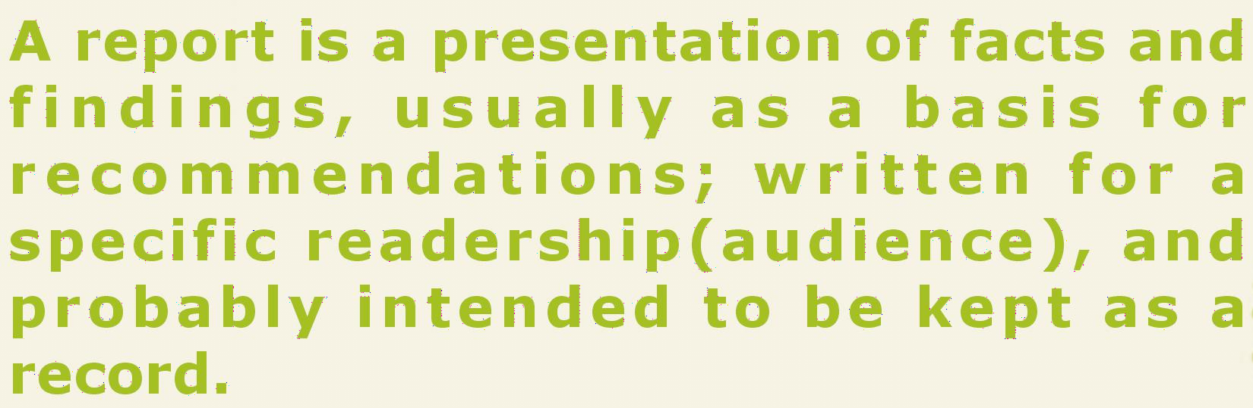

Report
Page 2

Slide 3

















A Report is:
Prepared in Writing
Provides Information & Guidance
Self Explanatory Document
Acts as a Permanent Record
Page 3

Slide 4
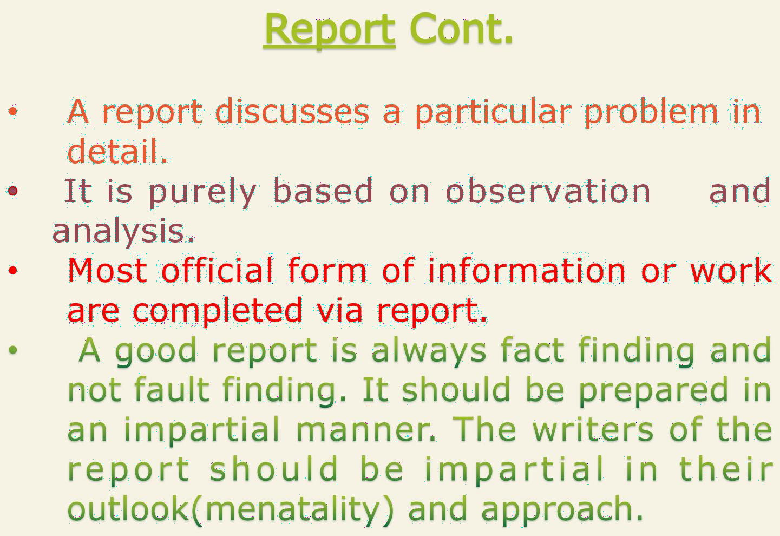
Page 4

Slide 5
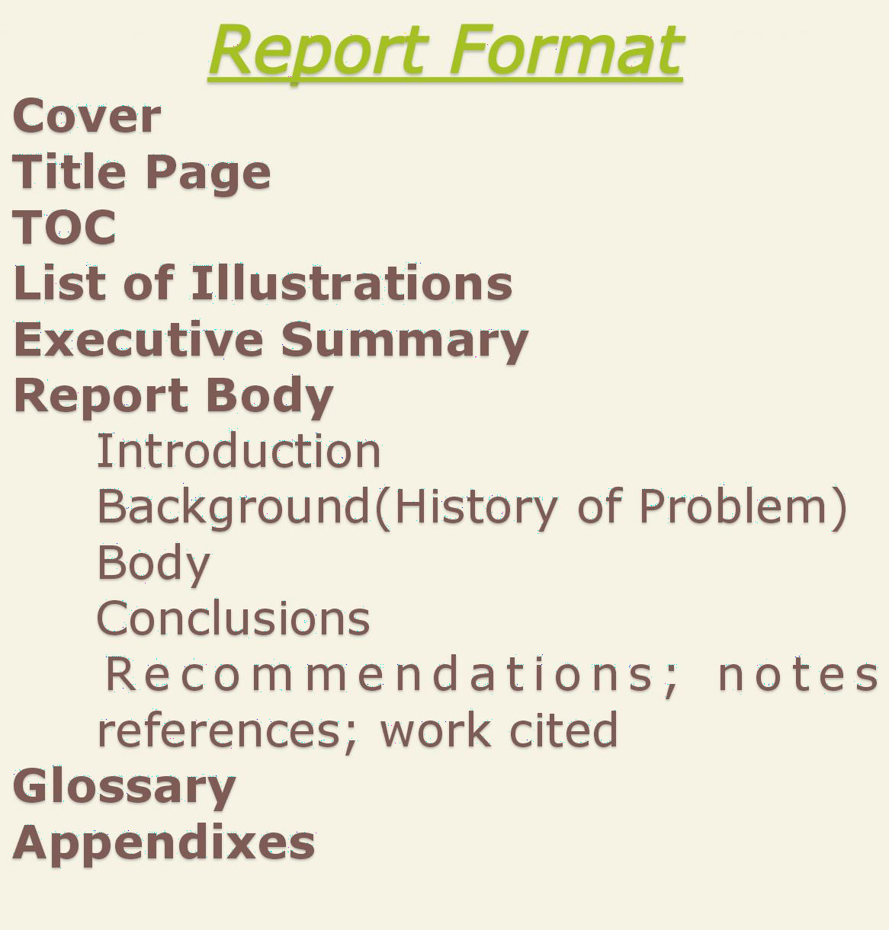
Page 5

Slide 6






Formal
Informal
Page 6

Slide 7

Page 7

Slide 8
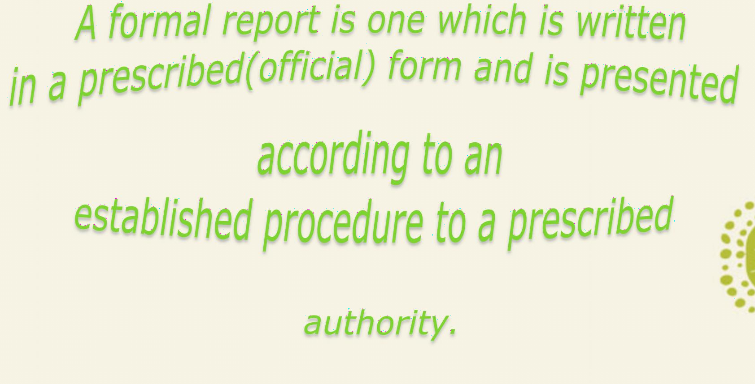
Page 8

Slide 9
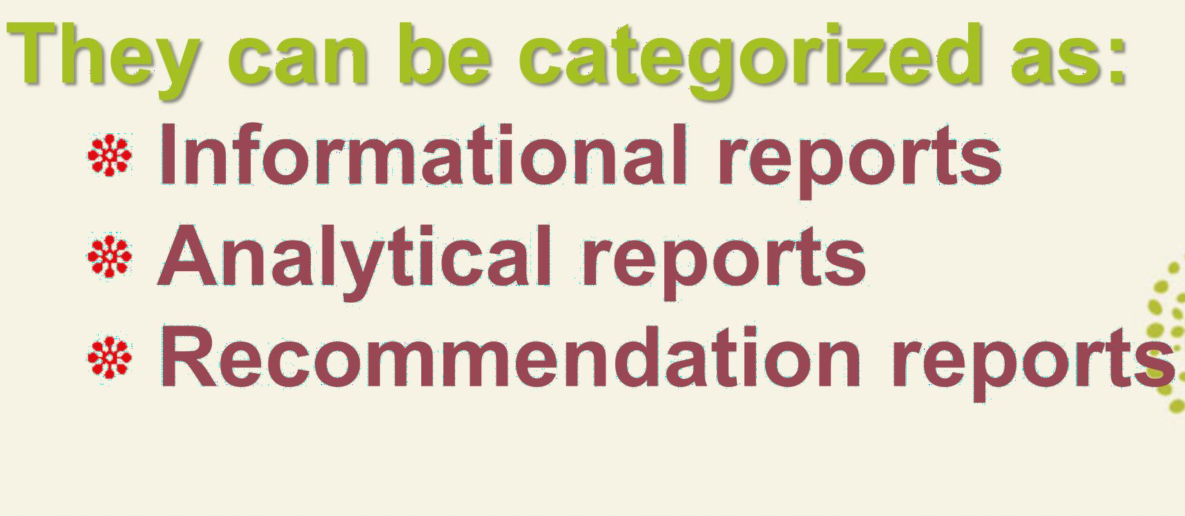
Page 9

Slide 10













INFORMATIONAL REPORTS
Informational reports present results so readers can understand a particular problem or situation.
Page 10

Slide 11









ANALYTICAL REPORTS
This type goes a step beyond presenting results. Analytical reports present results, analyze those results, and draw conclusions based on those results.
These reports attempt to describe why or how something happened and then to explain what it means.
Page 11

Slide 12





RECOMMENDATION REPORTS
This type advocate a particular course of action. This usually present the results and conclusions that support the recommendations.
This type is identical to analytical report.
Page 12

Slide 13




































































































































THE PLAN FOR PREPARING A FORMAL REPORT
Page 13

Slide 14

Page 14

Slide 15
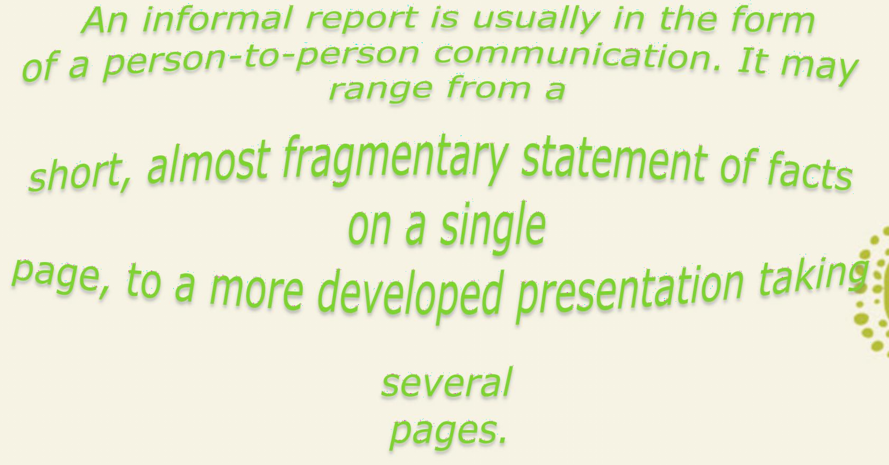
Page 15

Slide 16
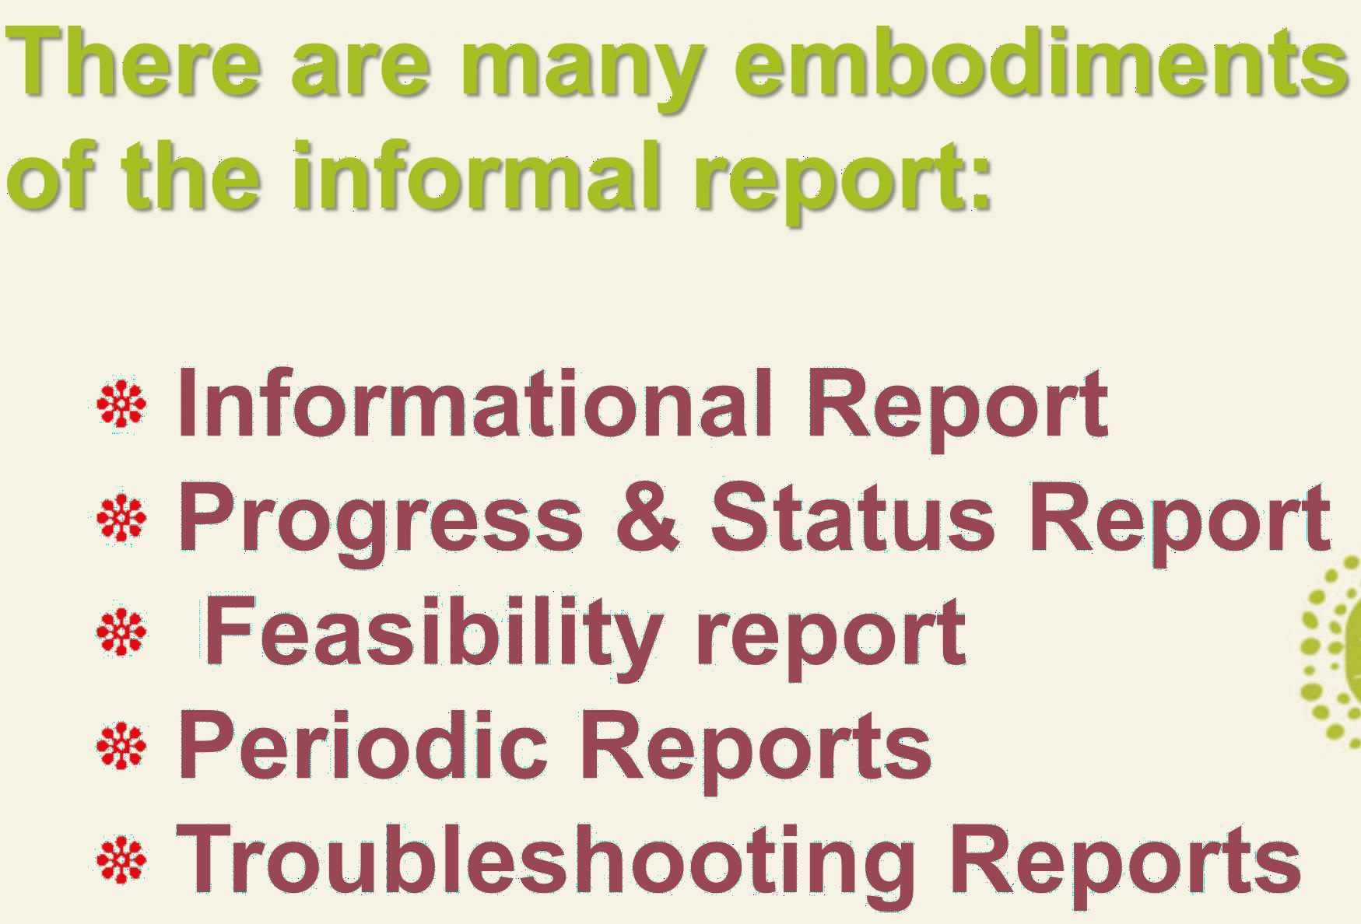
Page 16

Slide 17
PROGRESS REPORTS
Type of informal report that you have to write to explain how much progress is being made on something you have previously planned.
It describes an ongoing project.
It enables you to check on yourself so that you can better estimate what remains to be done and what resources, especially time you have to do it.
Page 17

Slide 18
STATUS REPORTS
It describes what is being accomplished in the present and with existing conditions in general.
It is just another type of progress report. It lays emphasize on existing conditions.
Page 18

Slide 19










FEASIBILITY REPORTS
A feasibility report is the results of a feasibility study. This report details whether or not a project should be undertaken and the reasons for that decision.
Page 19

Slide 20
PERIODIC REPORTS
These reports allows management to keep track of ongoing operations on a periodic or regular basis.
They can be filed daily, weekly, monthly, quarterly, yearly etc. They may even take the form of an elaborate and often costly formal report.
Page 20

Slide 21












TROUBLESHOOTING REPORTS
These informal reports are used by technicians to convey information regarding the analysis and correction of problems found in industrial products.
Page 21

Slide 22
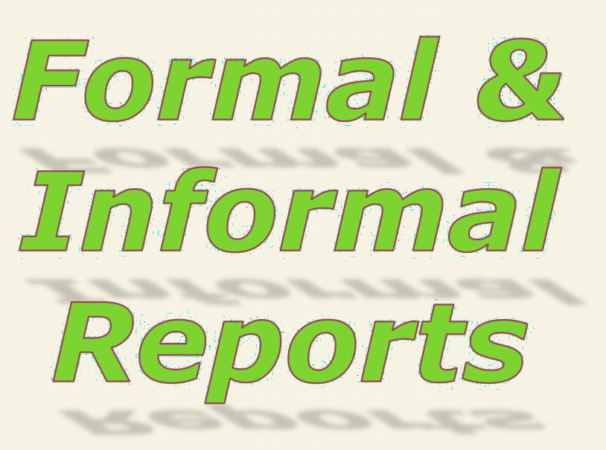
Page 22

Slide 23
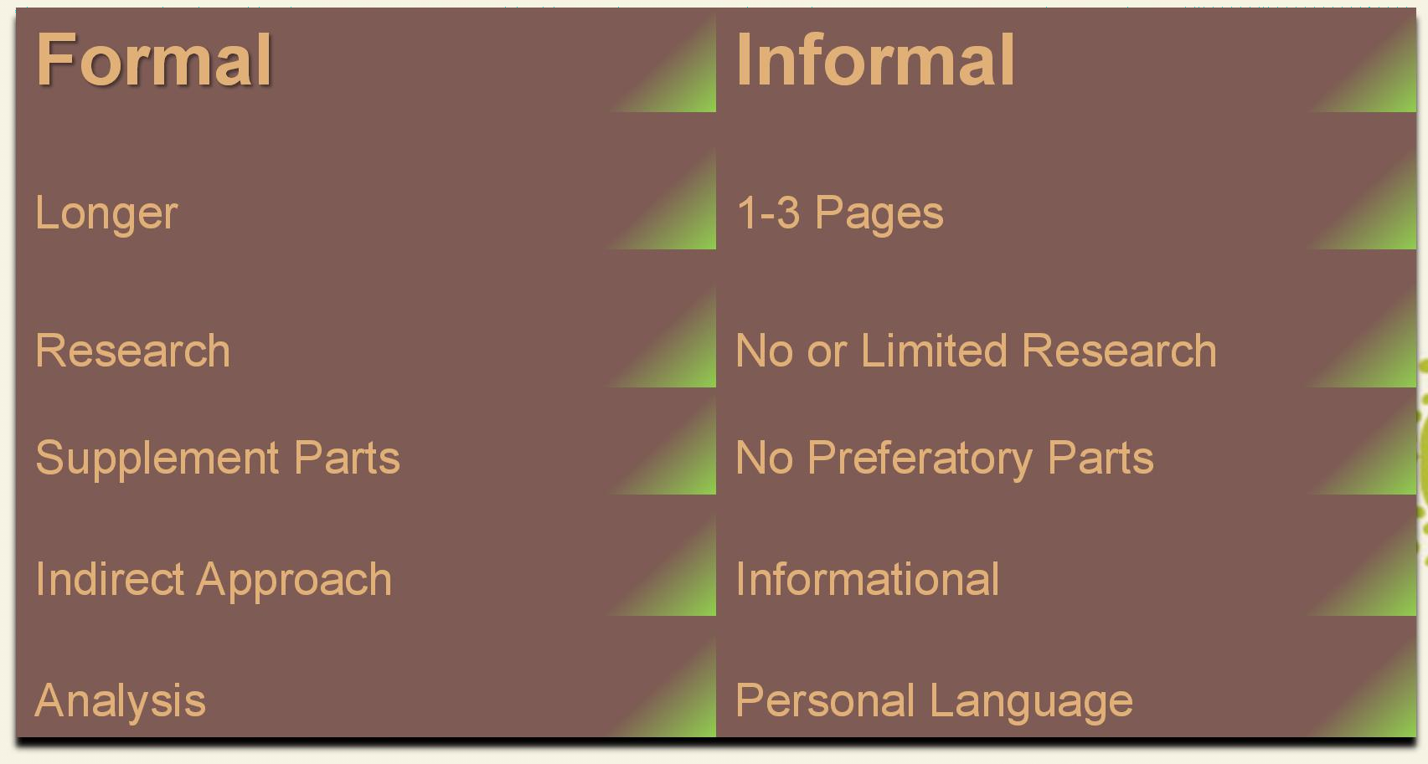
Informal
Longer
1-3 Pages
Research
No or Limited Research
Supplement Parts
No Preferatory Parts
Indirect Approach
Informational
Analysis
Personal Language
Page 23

Slide 24

Page 24

Slide 25
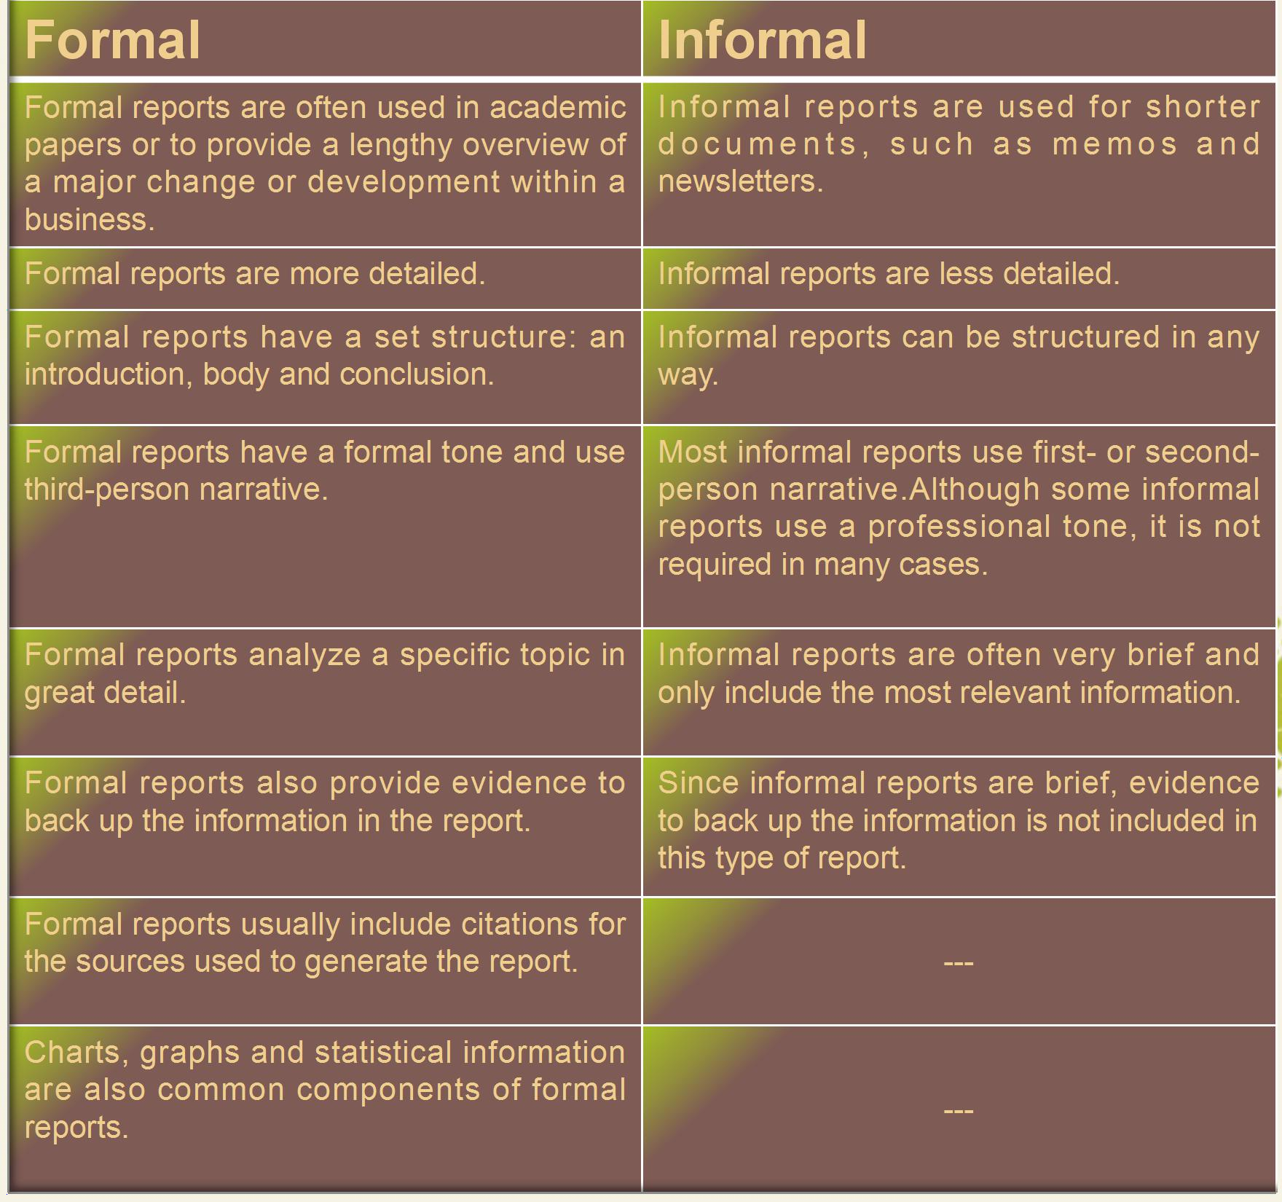
Formal
Informal
Informal reports are used for shorter d o c u m e n t s , s u c h a s m e m o s a n d newsletters.
Informal reports are less detailed.
Informal reports can be structured in any way.
Most informal reports use first- or second- person narrative.Although some informal reports use a professional tone, it is not required in many cases.
Informal reports are often very brief and only include the most relevant information.
Since informal reports are brief, evidence to back up the information is not included in this type of report.
Formal reports are often used in academic papers or to provide a lengthy overview of a major change or development within a business.
Formal reports are more detailed.
Formal reports have a set structure: an introduction, body and conclusion.
Formal reports have a formal tone and use third-person narrative.
Formal reports analyze a specific topic in great detail.
Formal reports also provide evidence to back up the information in the report.
Formal reports usually include citations for the sources used to generate the report.
Charts, graphs and statistical information are also common components of formal reports.
---
---
Page 25

Slide 26






Page 26

